Slide 1
ST.ANN’S COLLEGE OF ENGINEERING AND TECHNOLOGY CHIRALA
DEPARTEMENT OF ELECTRICAL AND ELECTRONIC ENGINEERING
BATCH NO:1
MATHEMATICAL MODELLING AND SPEED CONTROL OF PERMANENT MAGNET SYNCHRONOUS MACHINE
PROJECT ASSOCIATES:
V.N.V.YAMUNA(10F01A02B3)
N.LALITHA KUMARI(11JD5A0204)
G.SRIKANTH(11F05A0209)
M.HARSHAVARDHAN(08F01A240)
PROJECT GUIDE HEAD OF THE DEPARTEMENT
MR. A.PAVANKUMAR MR. S.V.D.ANIL KUMAR
ASSISTANT PROFESSOR ASSOCIATE PROFESSOR

Slide 2
ABSTRACT
This project deals with the detailed mathematical modeling and speed control of permanent magnet synchronous motor drive system using mat lab/simulink. In PMSM the conventional electro magnetic field poles are replaced by permanent magnets in rotor. A closed loop control system with a proportional integral (PI) controller in the speed loop has been designed to operate in constant torque and flux weakening regions. Pulse width modulation control scheme associated with pi controller has been used to reduce the steady state error and total harmonic distortion.PMSM has many applications like automotive and industrial automation including traction and robotics.

Slide 3
APPLICATIONS:
ELETRIC TRACTION
ROBOTICS
BIO MEDICAL
UPS SYSTEMS
CD DRIVES

Slide 4
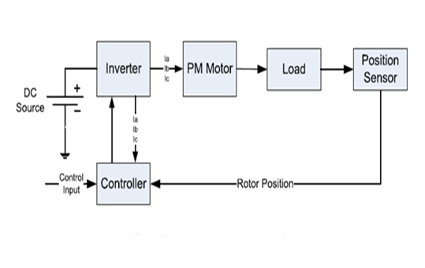
BLOCK DIAGRAM

Slide 5
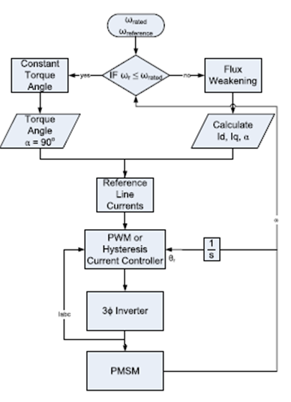
Flow chart

Slide 6
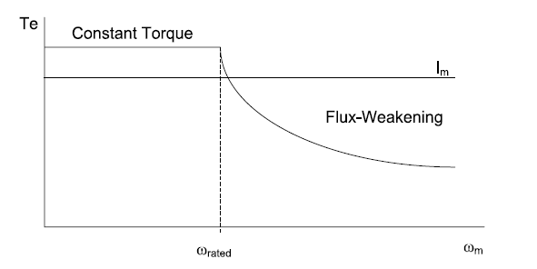
Speed torque characteristics

Slide 7
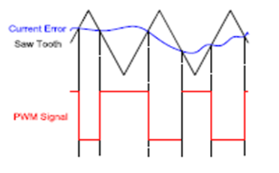
PWM controller
1.IT REDUCES THE HARMONICS
2.LOW POWER LOSS
3.HIGH EFFICIENCY

Slide 8
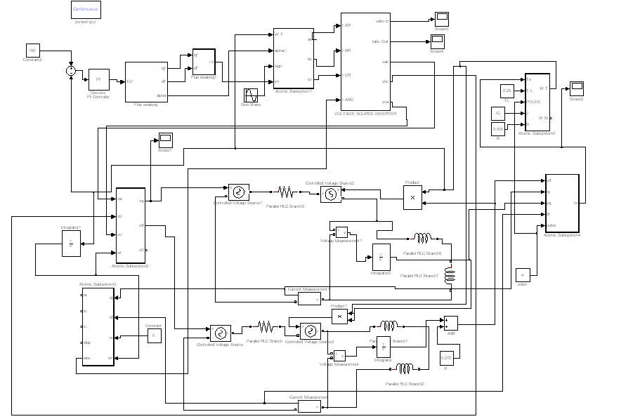
SIMULATION DIAGRAM

Slide 9
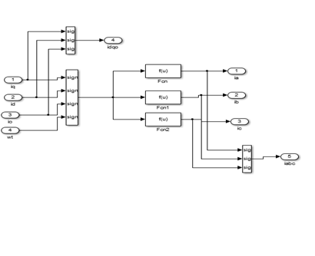
ABC TO DQ TRANSFORMATION:

Slide 10
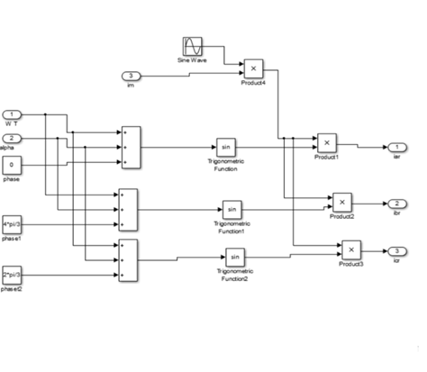
REFERENCE CURRENTS GENERATION

Slide 11
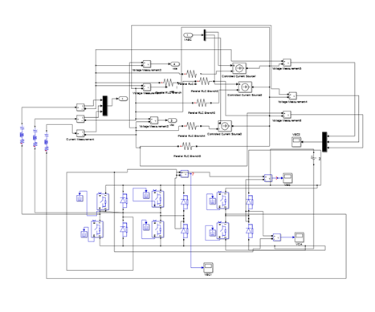
VOLTAGE SOURCE INVERTER

Slide 12
VOLTAGE SOURCE INVERTER:
VOLTAGE SOURCE INVERTER ARE DEVICES THAT CONVERTS DC TO AC SUPPLY.
VSI COMMONLY USED IN ADJUSTABLE SPEED DRIVES.
IGBTS ARE USED IN THESE VSI.

Slide 13
INSULATED GATE BIPOLAR TRANSISTOR
IT POSSES SELF TURN OFF CAPABILITY.
IN IGBT TURN ON LOSSES ARE LESS.
IT IS MANILY USED FOR MEDIUM POWER APPLICATION.
APPLICATIONS OF IGBT:
CHOPPERS
UPS

Slide 14
MODES OF OPERATION
CONSTANT TORQUE OPERATION:CONSTANT TORQUE OPERATION IS USED WHEN DESIRED SPEED IS LESS THAN REFERANCE SPEED.
CONSTANT POWER OPERATION:CONSTANT POWER OPERATION IS USED WHEN DESIRED SPEED IS ABOVE RATED SPEED.

Slide 15
PI CONTROLLER
PI CONTROLLER IS USED TO REDUCE STEADY STATE ERROR.
PI CONTROLLER INTRODUCE A ZERO IN THE SYSTEM AND INCREASE THE ORDER BY ONE.

Slide 16
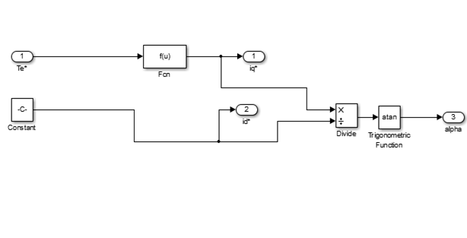
FLUX WEAKING CONTROLLER

Slide 17
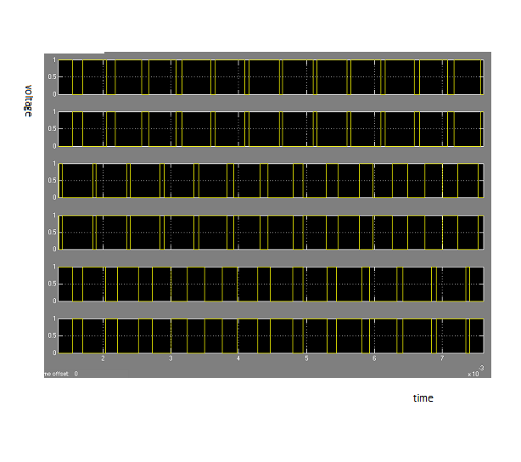
Pulses to IGBT(VOLTAGE VS TIME)

Slide 18
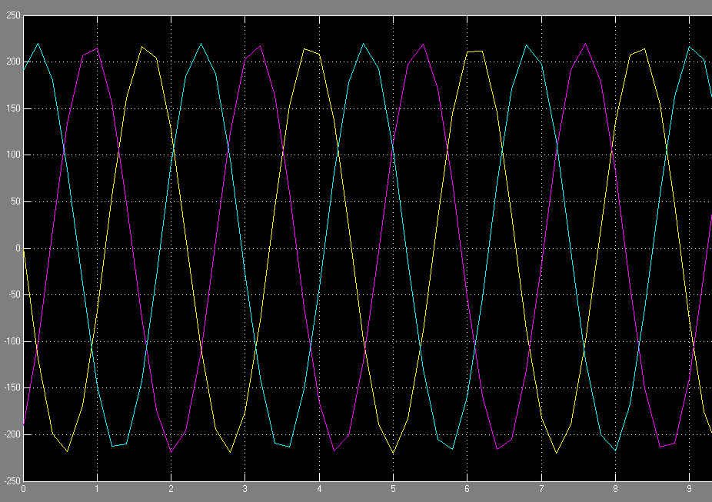
REFERANCE CURRENTS

Slide 19

OUTPUT VOLTAGES

Slide 20
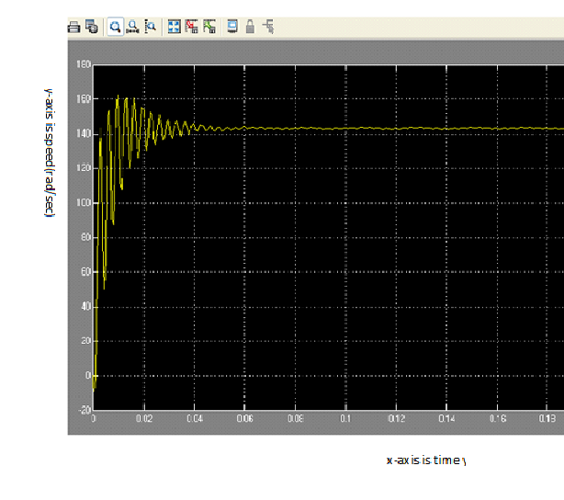
BELOW RATED SPEED

Slide 21
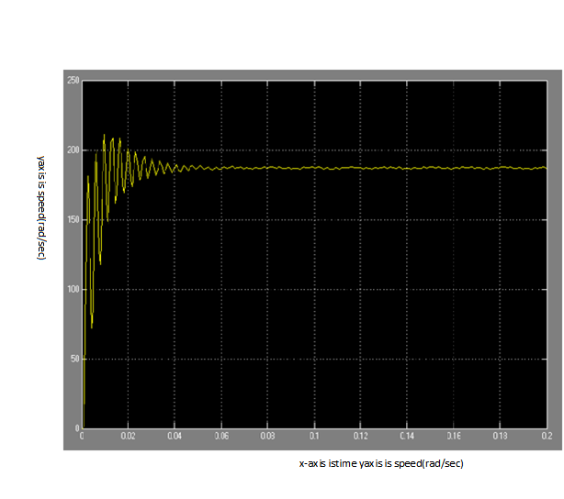
ABOVE RATED SPEED

Slide 22
Conclusion:
A SPEED CONTROLLER HAS BEEN DESIGNED SUCCESSFULLY FOR CLOSED LOOP OPERATION OF THE PMSM DRIVE SYSTEM SO THAT THE MOTOR RUNS AT THE COMMANDED SPEED(OR)REFERENCE SPEED.
THE SIMULATED SYSTEM HAS A FAST RESPONSE WITH PRACTICALLY ZERO STEADY STATE ERROR THUS VALIDATING THE DESIGN OF SPEED CONTROLLER
CONSTANT TORQUE METHOD IS USED FOR BELOW RATED SPEED FLUX WEAKENING METHOD IS USED FOR ABOVE RATED SPEED.

Slide 23
REFERANCE PAPERS
1.”Mathematical modelling and simulation of permanent syncronous motor”,by siva gangadhararao venna in international journal of advanced research in Eletrical,Electronics and Instrumentation Engineering
vol2,issue8,august2013.
2.R.krishnan,”Electric motor drives modeling,analysis and control”,prentice hall,2001.

Slide 24
THANK U

Slide 25
QUIRES

